Slide 1



RIVA
Real-Time Intelligent Vision Assistant

Slide 2
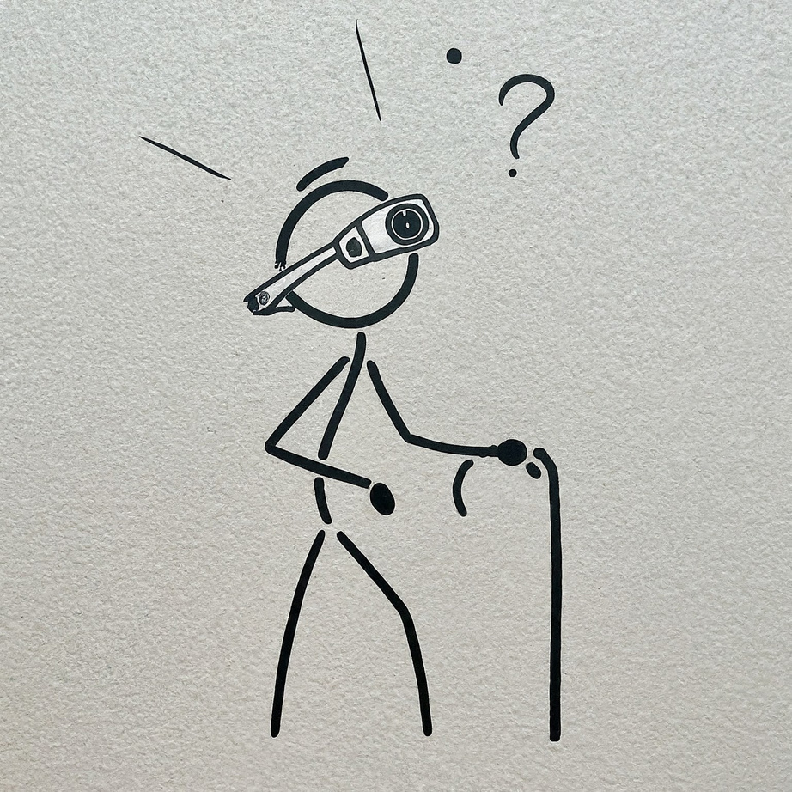
RIVA
Accessibility Innovation
Advanced Technology Integration
Environmental Perception

Slide 3
Our Vision
Vision
We want to help visually impaired people with...
Interaction with Environment.
Independence
Assistance
Guidance
Security

Slide 4


Vision Model
LLM Model
Text-To-Speech
Speech-To-Text
RIVA Pipeline
Input: Objects & Distance
USER
Input: Question/Task
Environment

Slide 5





Seeing AI
Seeing AI is an artificial intelligence application developed by Microsoft for iOS. Seeing AI uses the device camera to identify people and objects, and then the app audibly describes those objects for people with visual impairment.
Available Solutions
Envision Glasses
Envision Glasses are AI-powered smart glasses for blind or visually impaired users, narrating the world around them through voice descriptions of text, objects, scenes, and even colors, promoting independence and greater access to visual information.

Slide 6

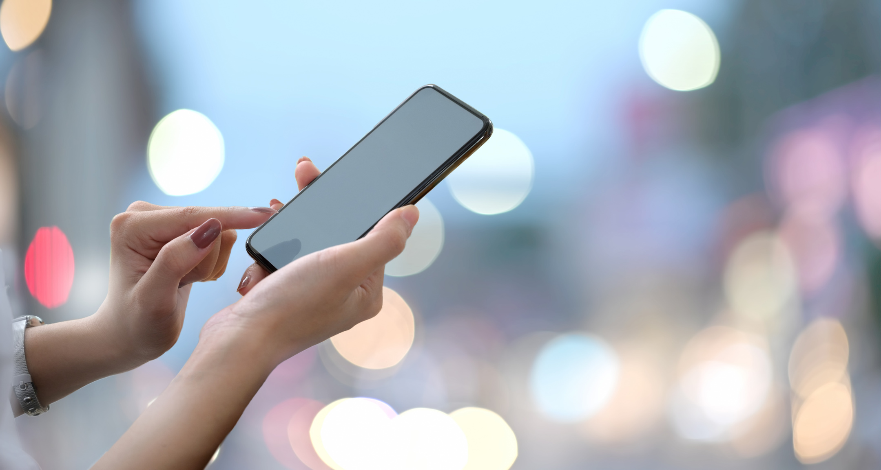
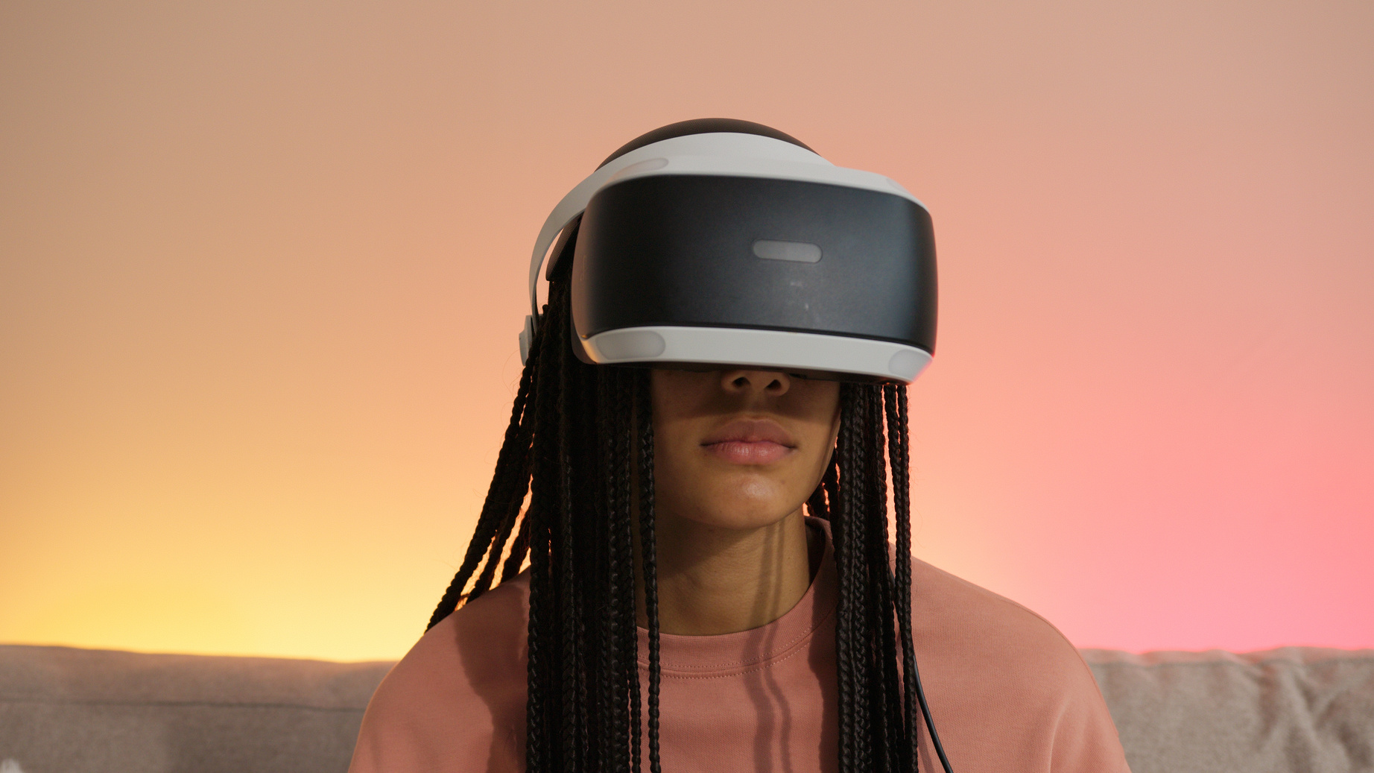
Platform
ADVANTAGES:-
Less Manufacturing Cost
Subscription Based
DISADVANTAGES:-
Device Specs (camera)
Compatibility
ADVANTAGES:-
Compatible
One-Time Device Cost
DISADVANTAGES:-
More Manufacturing Cost

Slide 7
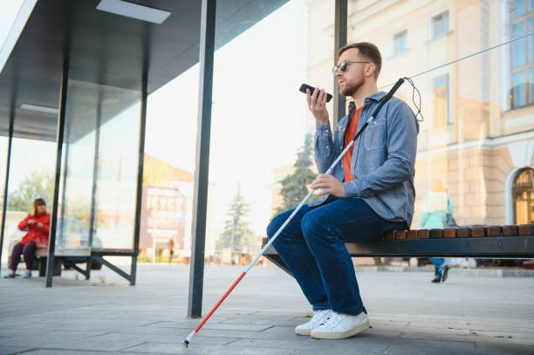
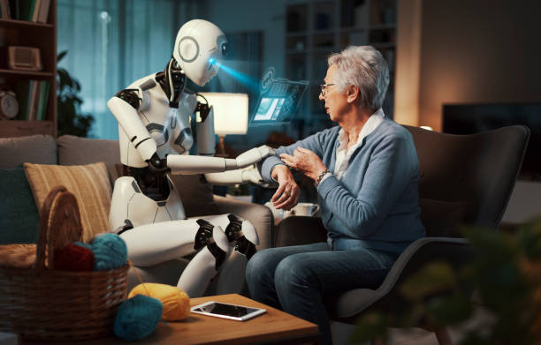
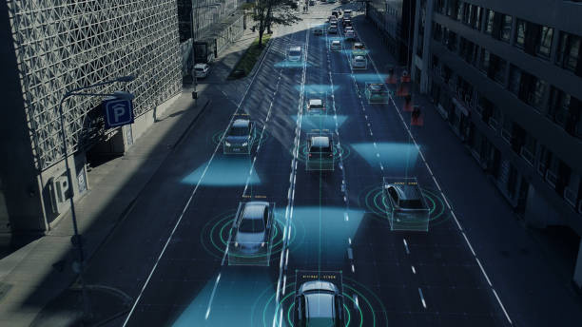
Future Applications
Blind Person
Robotics
Autonomous Cars

Slide 8

Prototype Budget
Depth Sensing Camera: $650
Open AI Integration: $100
Cloud Resources: $4000
Mic: $500
Total: $5250

Slide 9

POC
Voice Commands
Object Detection
Distance Calculation
Describing Frames

Slide 10
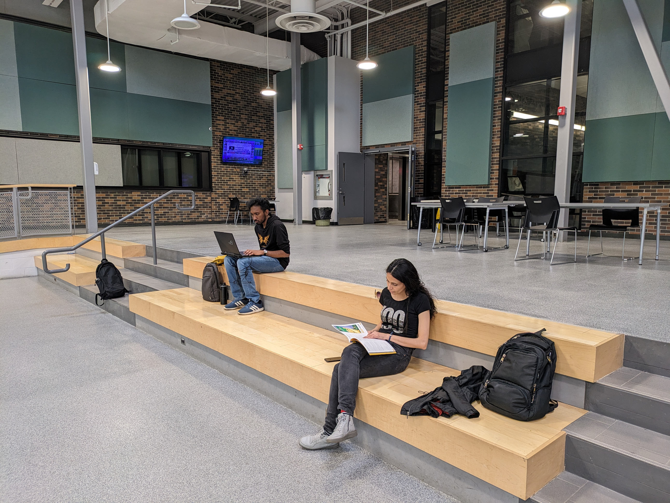

Slide 11
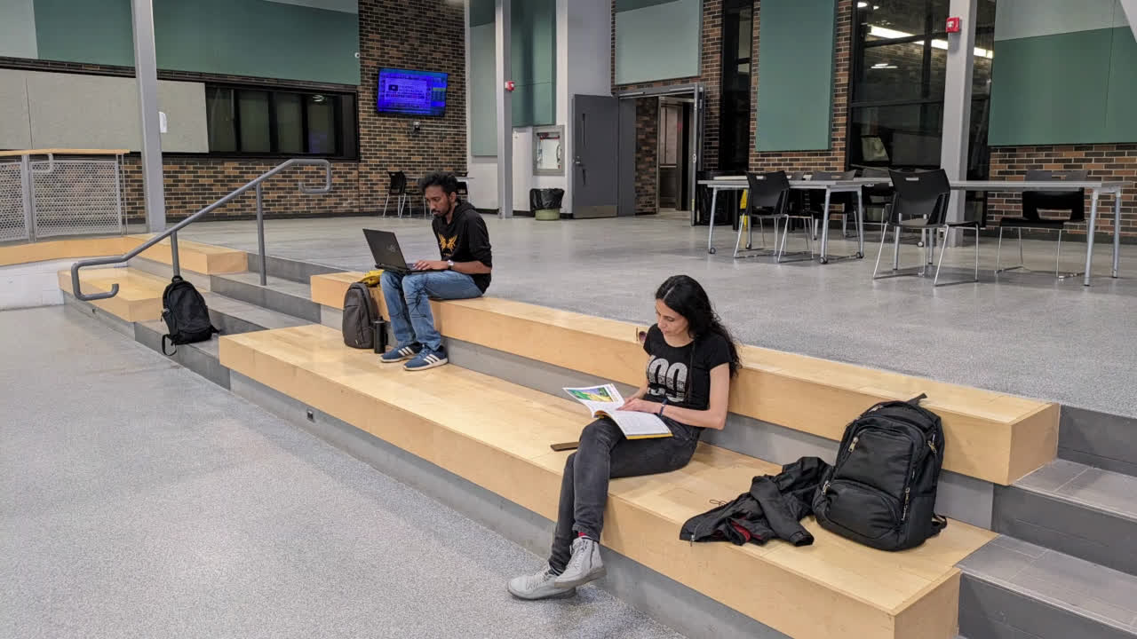

Slide 12
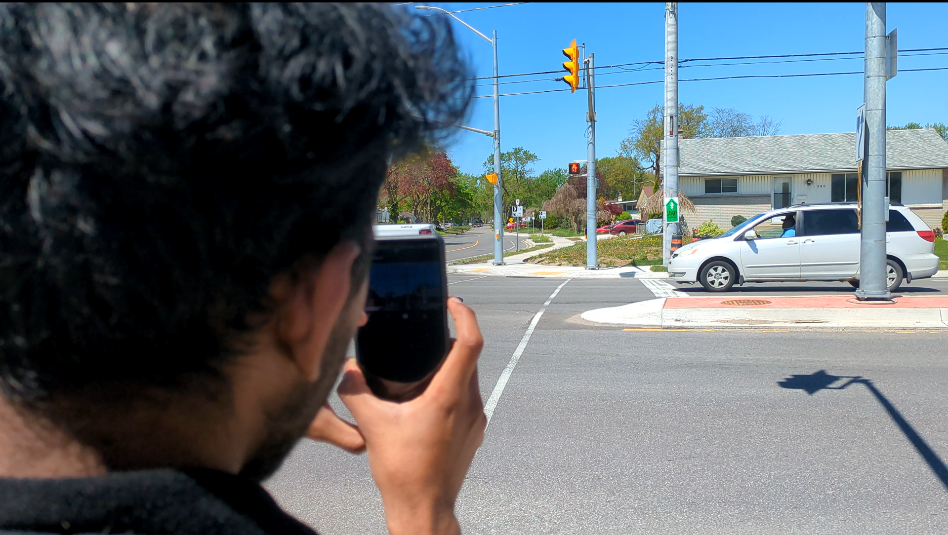

Slide 13
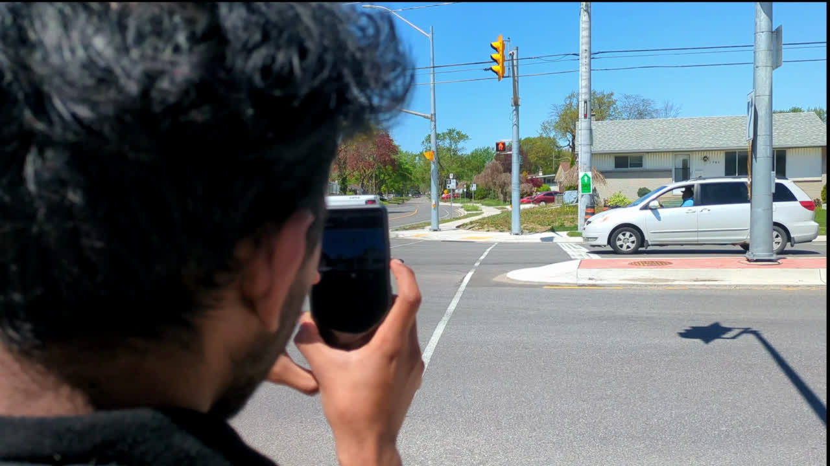

Slide 14
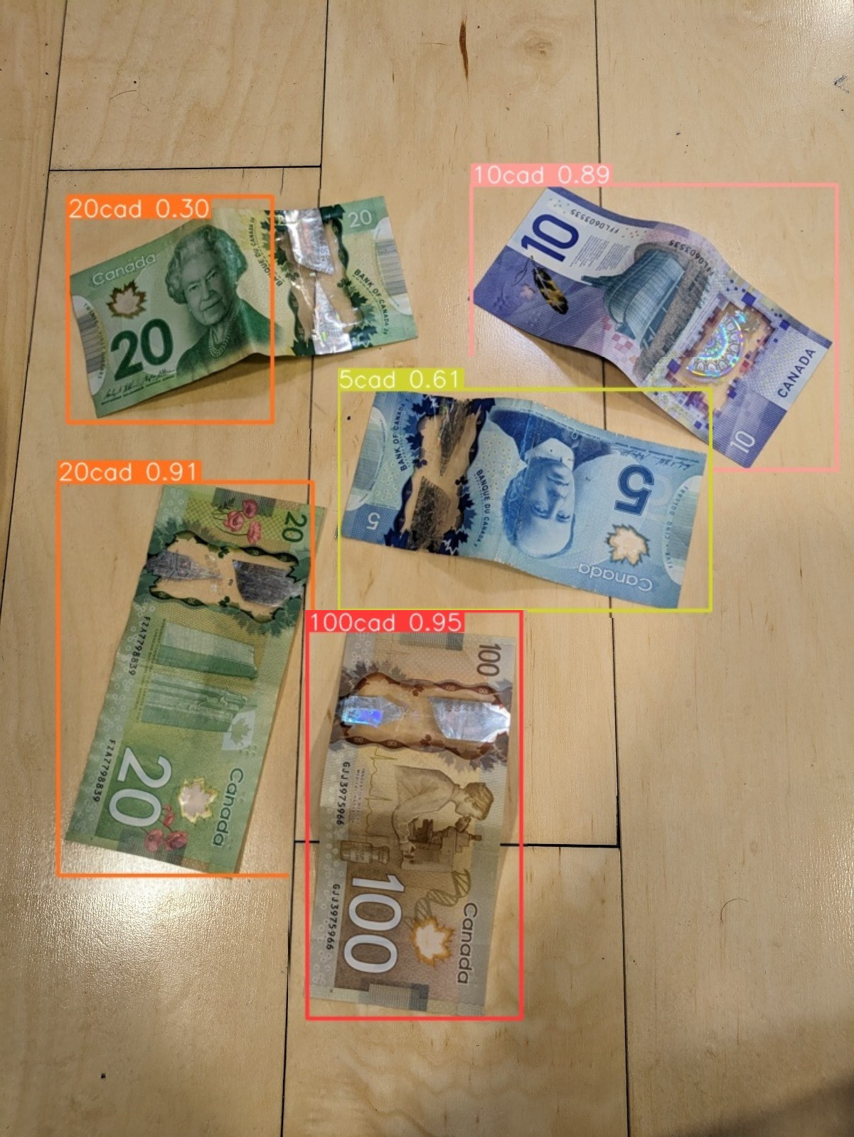

Slide 15
Timeline
Phase I
Developed a model that describes the environment in real-time
Phase II
Refining the model to enhance accuracy and processing speed
Prototype Completion Time
3-4 months
Timeline Resources
Resources
Wearable Smart Glasses
Depth Sensor Camera
Cloud

Slide 16


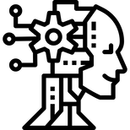


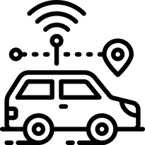
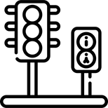
Team RIVA

